Slide 1
My Footprint!
Jadon Games Hong Yi Meng Suraj Patel Kevin Patel

Slide 2
Purpose
Allow users to calculate various types of carbon emissions

Slide 3
Features
Sign up/ Sign in
Flight’s greenhouse gas emissions
Calculate and compare vehicle emissions
Household carbon emissions
Total carbon footprint
Compare and contrast

Slide 4
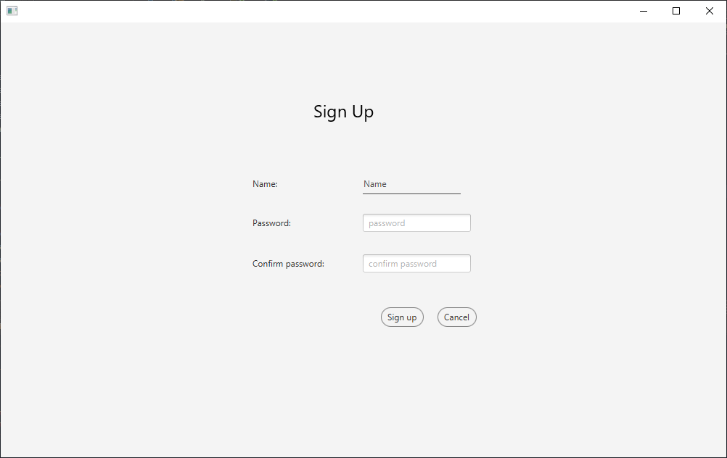
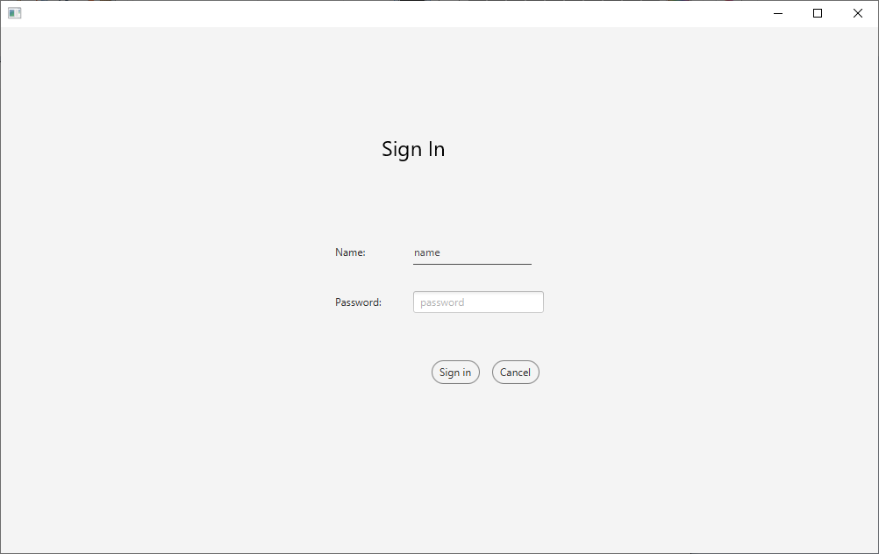
Sign up/ sign in
Capable of creating a new account and then signing into the created account. With limitations such as restricting logins with false credentials.

Slide 5
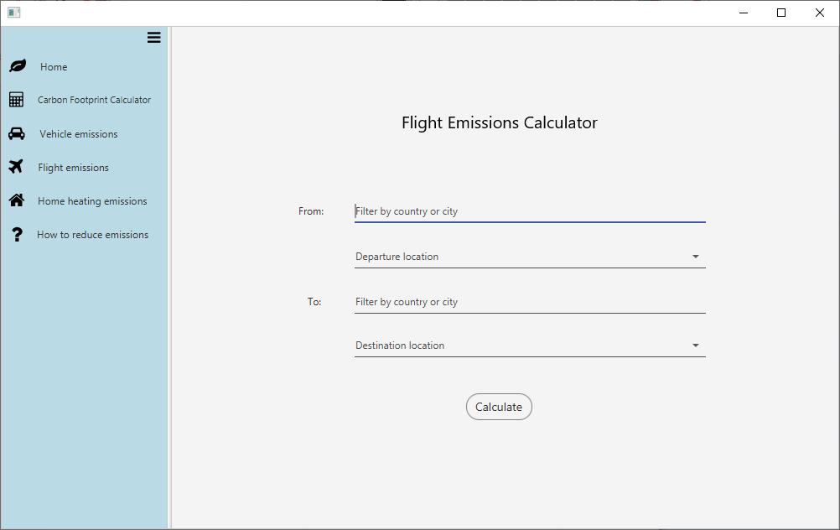
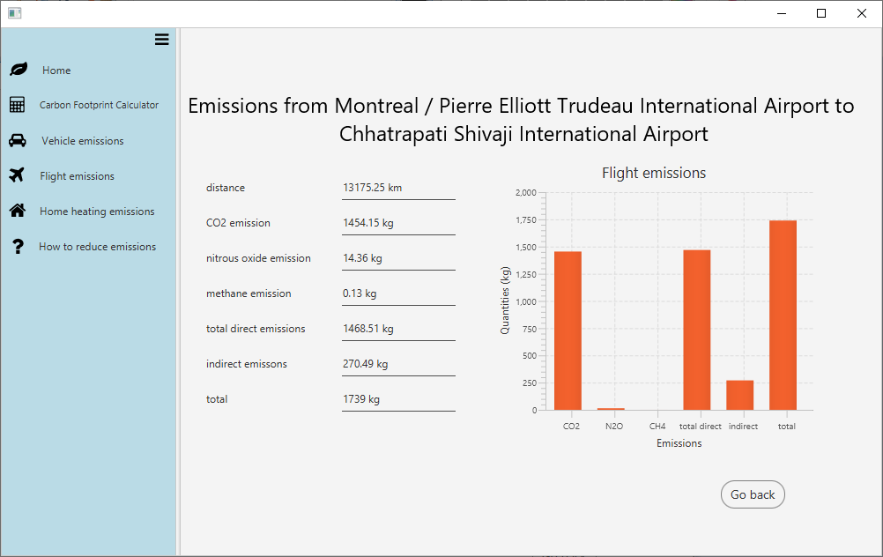
Flight’s greenhouse gas emissions
Calculates the emissions based on distance travelled from destination to destination

Slide 6
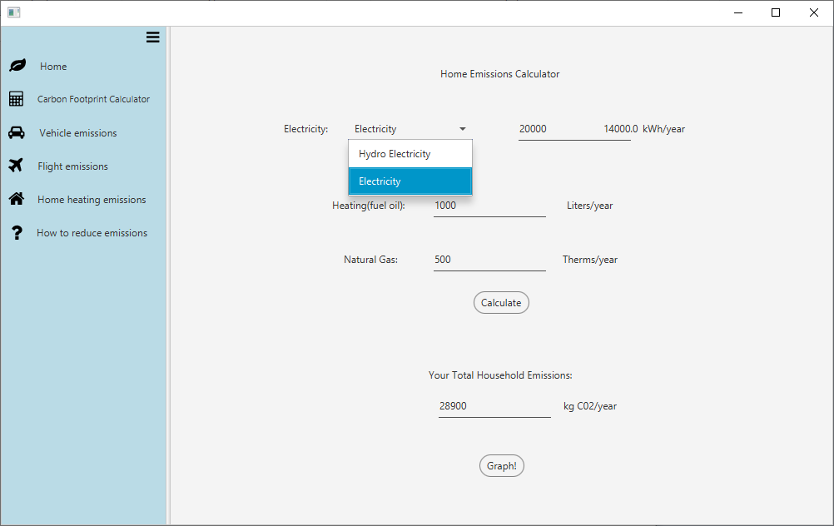
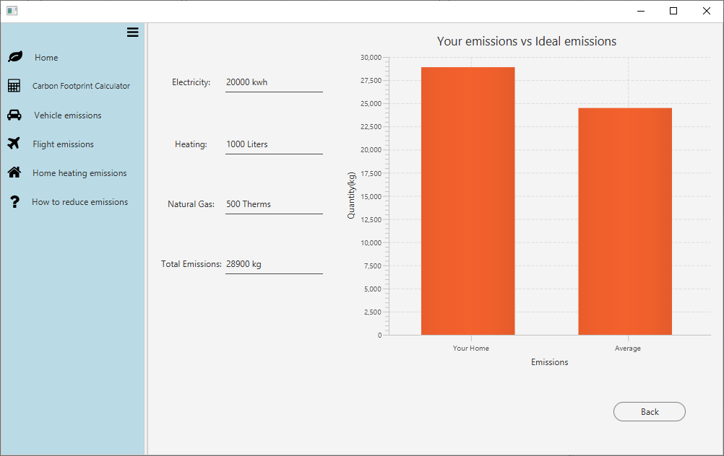
Household carbon emissions
Calculate the household carbon emissions based on various factors

Slide 7
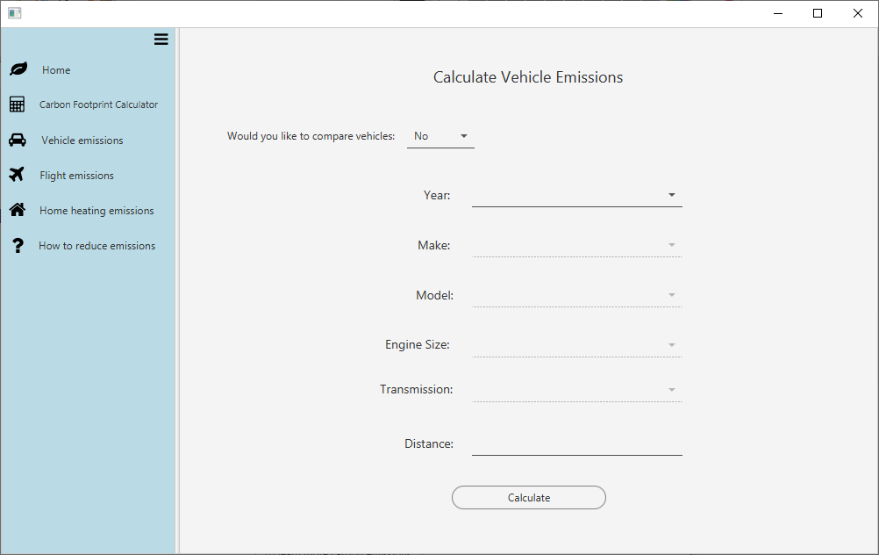
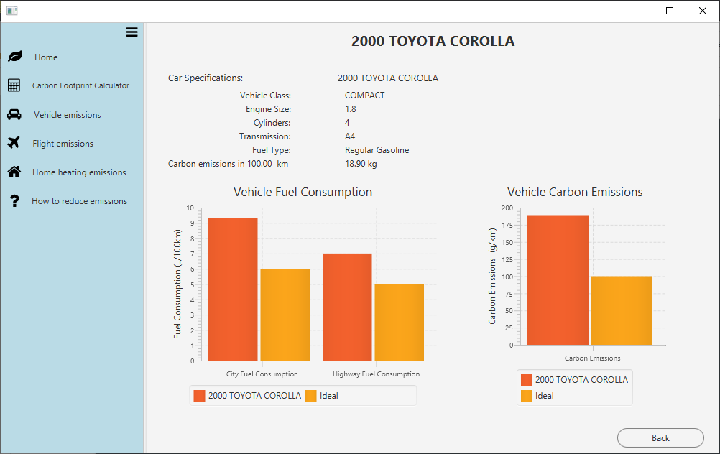
Vehicle Emissions
Calculate emissions for a specific vehicle

Slide 8
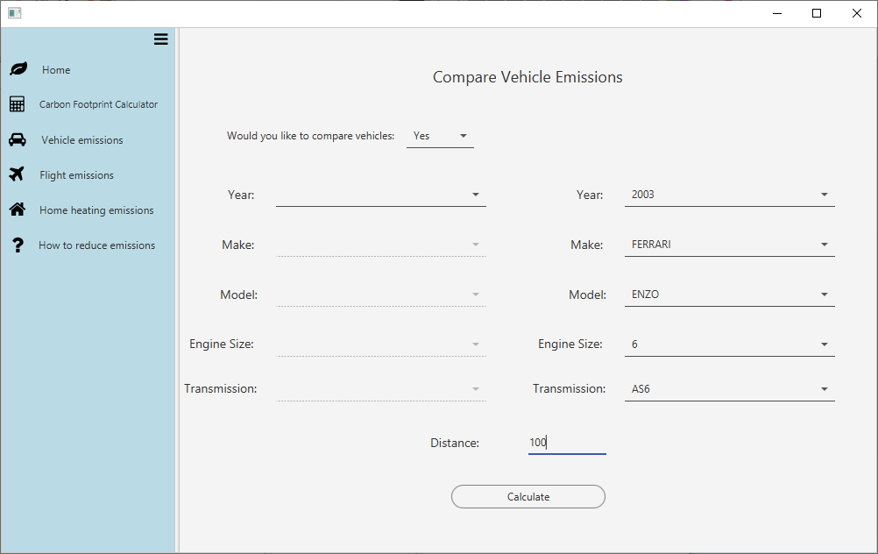
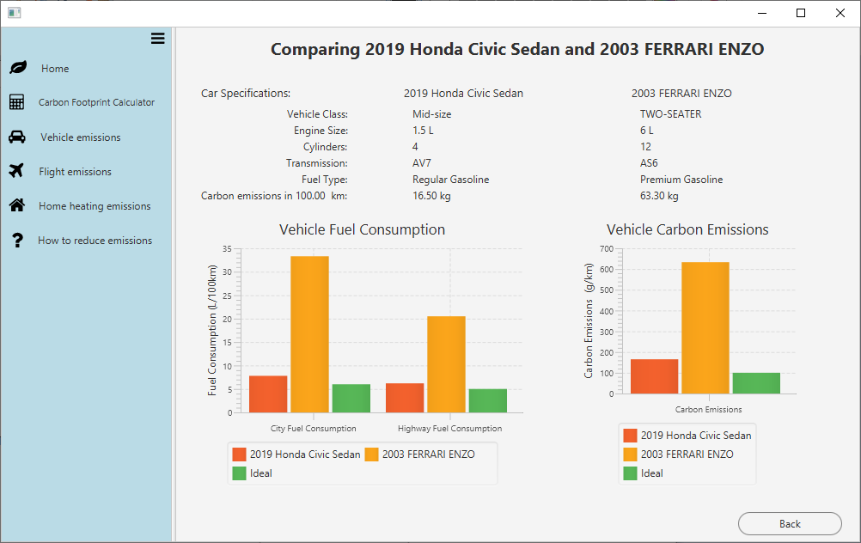
Compare Vehicle Emissions
Calculate and compare emissions for two specific vehicles

Slide 9
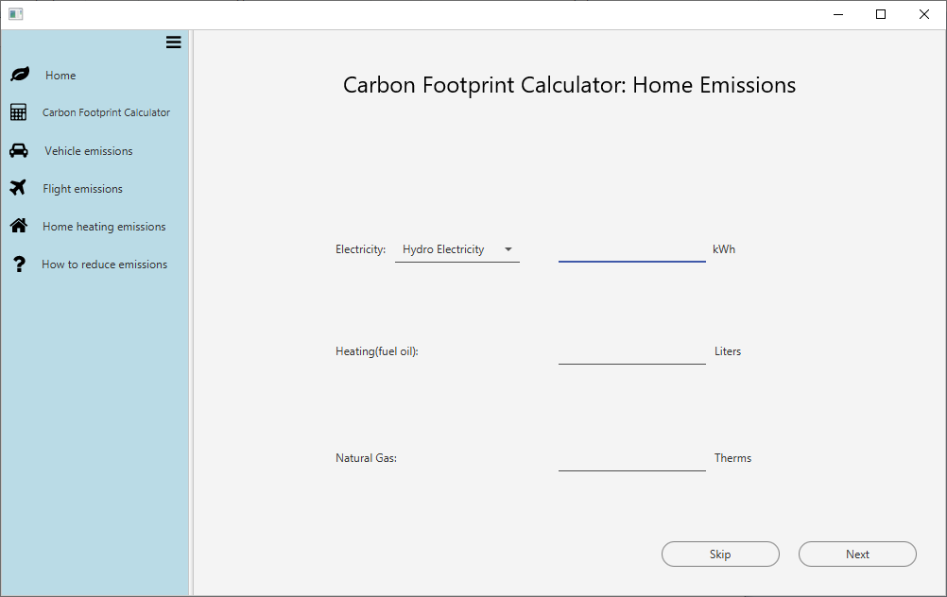
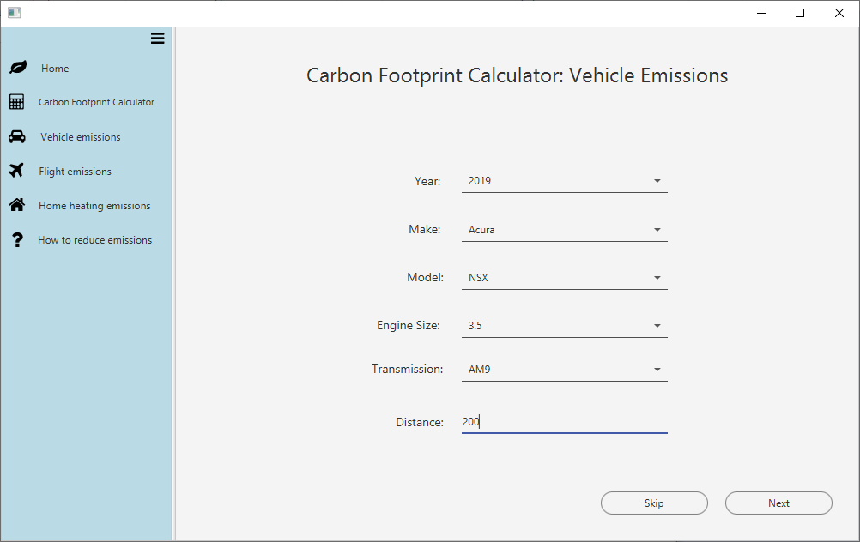
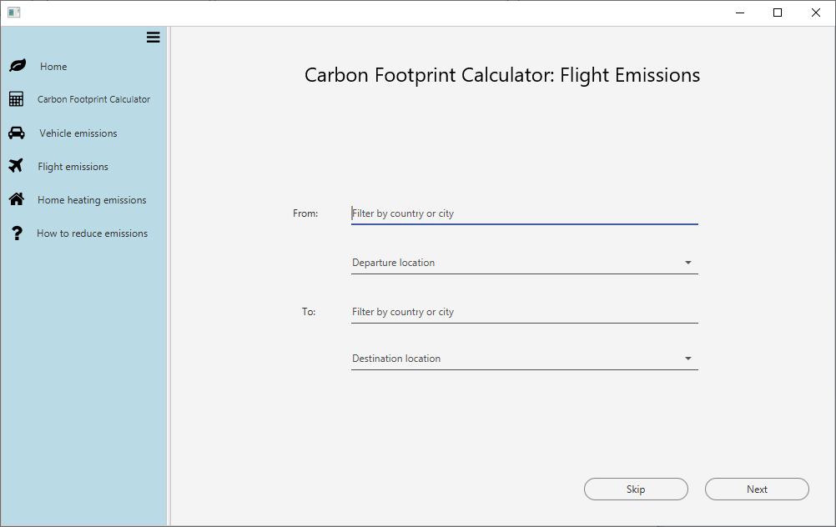
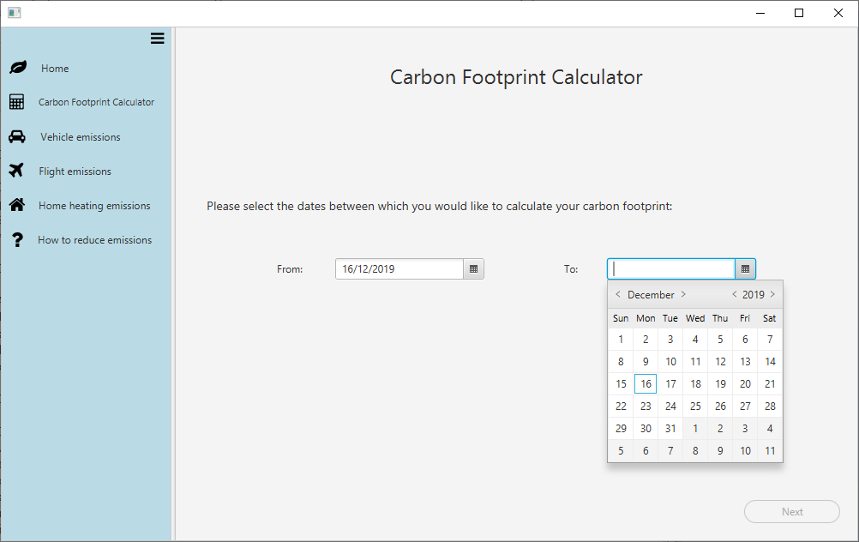
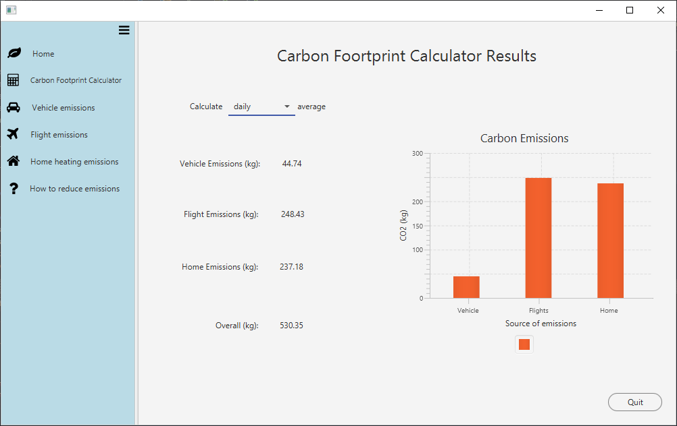
Total Carbon footprint
Combines the other features to get an overall approximation of carbon emissions

Slide 10
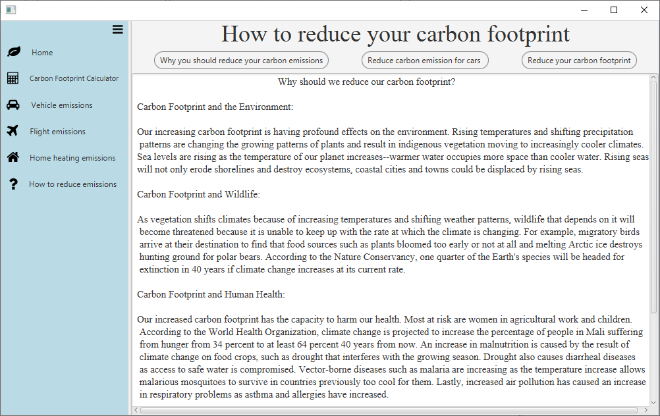
Reducing Your Carbon Emissions
Information about why you should reduce your emissions
Useful tips on how to reduce your emissions

